Slide 1
Chapter 5
More SQL: Complex Queries, Triggers, Views, and Schema Modification

Slide 2
Chapter 5 Outline
More Complex SQL Retrieval Queries
Specifying Constraints as Assertions and Actions as Triggers
Views (Virtual Tables) in SQL
Schema Change Statements in SQL

Slide 3
More Complex SQL Retrieval Queries
Additional features allow users to specify more complex retrievals from database:
  Nested queries, joined tables, outer joins, aggregate functions, and grouping

Slide 4
Comparisons Involving NULL and Three-Valued Logic
Meanings of NULL
  Unknown value
  Unavailable or withheld value
  Not applicable attribute
Each individual NULL value considered to be different from every other NULL value
SQL uses a three-valued logic:
  TRUE, FALSE, and UNKNOWN

Slide 5
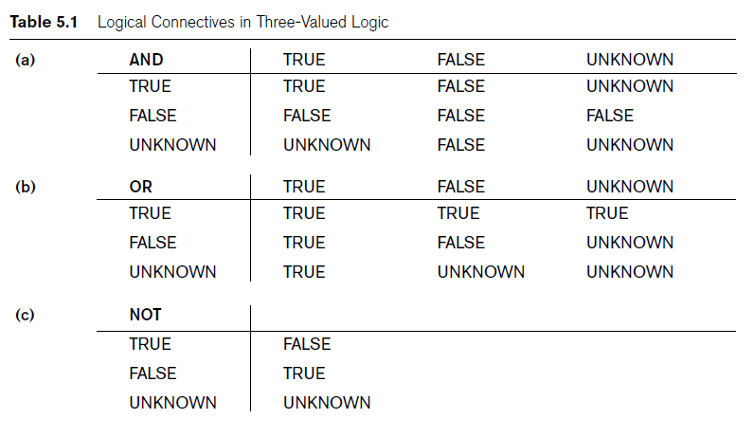
Comparisons Involving NULL and Three-Valued Logic (cont’d.)

Slide 6

Comparisons Involving NULL and Three-Valued Logic (cont’d.)
SQL allows queries that check whether an attribute value is NULL
  IS or IS NOT NULL

Slide 7
Nested Queries, Tuples, and Set/Multiset Comparisons
Nested queries
  Complete select-from-where blocks within WHERE clause of another query
  Outer query
Comparison operator IN
  Compares value v with a set (or multiset) of values V
  Evaluates to TRUE if v is one of the elements in V

Slide 8

Nested Queries (cont’d.)

Slide 9

Nested Queries (cont’d.)
Use tuples of values in comparisons
  Place them within parentheses

Slide 10

Nested Queries (cont’d.)
Use other comparison operators to compare a single value v
  = ANY (or = SOME) operator
    Returns TRUE if the value v is equal to some value in the set V and is hence equivalent to IN
  Other operators that can be combined with ANY (or SOME): >, >=, <, <=, and <>

Slide 11

Nested Queries (cont’d.)
Avoid potential errors and ambiguities
  Create tuple variables (aliases) for all tables referenced in SQL query

Slide 12
Correlated Nested Queries
Correlated nested query
  Evaluated once for each tuple in the outer query

Slide 13
The EXISTS and UNIQUE Functions in SQL
EXISTS function
  Check whether the result of a correlated nested query is empty or not
EXISTS and NOT EXISTS
  Typically used in conjunction with a correlated nested query
SQL function UNIQUE(Q)
  Returns TRUE if there are no duplicate tuples in the result of query Q

Slide 14

Explicit Sets and Renaming of Attributes in SQL
Can use explicit set of values in WHERE clause
Use qualifier AS followed by desired new name
  Rename any attribute that appears in the result of a query

Slide 15

Joined Tables in SQL and Outer Joins
Joined table
  Permits users to specify a table resulting from a join operation in the FROM clause of a query
The FROM clause in Q1A
  Contains a single joined table

Slide 16
Joined Tables in SQL and Outer Joins (cont’d.)
Specify different types of join
  NATURAL JOIN
  Various types of OUTER JOIN
NATURAL JOIN on two relations R and S
  No join condition specified
  Implicit EQUIJOIN condition for each pair of attributes with same name from R and S

Slide 17
Joined Tables in SQL and Outer Joins (cont’d.)
Inner join
  Default type of join in a joined table
  Tuple is included in the result only if a matching tuple exists in the other relation
LEFT OUTER JOIN
  Every tuple in left table must appear in result
  If no matching tuple
    Padded with NULL values for attributes of right table

Slide 18
Joined Tables in SQL and Outer Joins (cont’d.)
RIGHT OUTER JOIN
  Every tuple in right table must appear in result
  If no matching tuple
    Padded with NULL values for the attributes of left table
FULL OUTER JOIN
Can nest join specifications

Slide 19
Aggregate Functions in SQL
Used to summarize information from multiple tuples into a single-tuple summary
Grouping
  Create subgroups of tuples before summarizing
Built-in aggregate functions
  COUNT, SUM, MAX, MIN, and AVG
Functions can be used in the SELECT clause or in a HAVING clause

Slide 20

Aggregate Functions in SQL (cont’d.)
NULL values discarded when aggregate functions are applied to a particular column

Slide 21
Grouping: The GROUP BY and HAVING Clauses
Partition relation into subsets of tuples
  Based on grouping attribute(s)
  Apply function to each such group independently
GROUP BY clause
  Specifies grouping attributes
If NULLs exist in grouping attribute
  Separate group created for all tuples with a NULL value in grouping attribute

Slide 22

Grouping: The GROUP BY and HAVING Clauses (cont’d.)
HAVING clause
  Provides a condition on the summary information

Slide 23

Discussion and Summary of SQL Queries

Slide 24
Specifying Constraints as Assertions and Actions as Triggers
CREATE ASSERTION
  Specify additional types of constraints outside scope of built-in relational model constraints
CREATE TRIGGER
  Specify automatic actions that database system will perform when certain events and conditions occur

Slide 25

Specifying General Constraints as Assertions in SQL
CREATE ASSERTION
  Specify a query that selects any tuples that violate the desired condition
  Use only in cases where it is not possible to use CHECK on attributes and domains

Slide 26
Introduction to Triggers in SQL
CREATE TRIGGER statement
  Used to monitor the database
Typical trigger has three components:
  Event(s)
  Condition
  Action

Slide 27
Views (Virtual Tables) in SQL
Concept of a view in SQL
  Single table derived from other tables
  Considered to be a virtual table

Slide 28

Specification of Views in SQL
CREATE VIEW command
  Give table name, list of attribute names, and a query to specify the contents of the view

Slide 29
Specification of Views in SQL (cont’d.)
Specify SQL queries on a view
View always up-to-date
  Responsibility of the DBMS and not the user
DROP VIEW command
  Dispose of a view

Slide 30
View Implementation, View Update, and Inline Views
Complex problem of efficiently implementing a view for querying
Query modification approach
  Modify view query into a query on underlying base tables
  Disadvantage: inefficient for views defined via complex queries that are time-consuming to execute

Slide 31
View Implementation
View materialization approach
  Physically create a temporary view table when the view is first queried
  Keep that table on the assumption that other queries on the view will follow
  Requires efficient strategy for automatically updating the view table when the base tables are updated

Slide 32
View Implementation (cont’d.)
Incremental update strategies
  DBMS determines what new tuples must be inserted, deleted, or modified in a materialized view table

Slide 33
View Update and Inline Views
Update on a view defined on a single table without any aggregate functions
  Can be mapped to an update on underlying base table
View involving joins
  Often not possible for DBMS to determine which of the updates is intended

Slide 34
View Update and Inline Views (cont’d.)
Clause WITH CHECK OPTION
  Must be added at the end of the view definition if a view is to be updated
In-line view
  Defined in the FROM clause of an SQL query

Slide 35
Schema Change Statements in SQL
Schema evolution commands
  Can be done while the database is operational
  Does not require recompilation of the database schema

Slide 36
The DROP Command
DROP command
  Used to drop named schema elements, such as tables, domains, or constraint
Drop behavior options:
  CASCADE and RESTRICT
Example:
  DROP SCHEMA COMPANY CASCADE;

Slide 37
The ALTER Command
Alter table actions include:
  Adding or dropping a column (attribute)
  Changing a column definition
  Adding or dropping table constraints
Example:
  ALTER TABLE COMPANY.EMPLOYEE ADD COLUMN Job VARCHAR(12);
To drop a column
  Choose either CASCADE or RESTRICT

Slide 38

The ALTER Command (cont’d.)
Change constraints specified on a table
  Add or drop a named constraint

Slide 39
Summary
Complex SQL:
  Nested queries, joined tables, outer joins, aggregate functions, grouping
CREATE ASSERTION and CREATE TRIGGER
Views
  Virtual or derived tables

